Slide 1
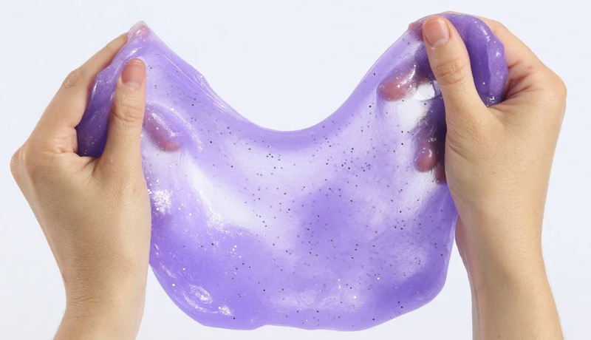

May 2025 Buy Trip
Notes:
Out of China Sourcing, in next trip, we will present the OOC items to Marie.
cost saving, Kmart is ask for 2.5% saving. otherwise, they are moving items to other supplier(that is what Jolie said).
Sales for new items, Marie will share with Mark.

Slide 2
Notes:
update the mix in size to be compliant
Price is not a concern.

Slide 3

THANK YOU

